Slide 1

Devops Community Chapter 2 Czyli: jak przestałem klikać I pokochałem automatyzację

Slide 2
Agenda
Introduction – Robert Pruski
Evolution of deployment mechanisms – Adam Wałach
From servers to containers
From containers, where?
Kubernetes automatization
Smarter deployments – Tomasz Heflik
Networking break - 15min
Kubernetes automatization
Autoscaling – Tomasz Pietrek
Helm: deploying simple – Jakub Błaszczyk
How to automate the automat?
Networking session
Office trip
Q&A
Speed Interviews
Notes:
Krótki rys historyczny, dlaczego wogóle wybieramy k8s I kontenery
Smarter deployments - jak zarządzać deploymentowmi
Autoscalling – jeśli możemy łatwo zarządzać to możemy pomyśleć o ciekawych żeczach taki jak skalowanie
I bardzo fajny temat na sam koniec – helm – manager pakietów do k8s

Slide 3

Hack Your Career
Wykłady - AEiI
(14:00 – 15:30, s.428)
Warszaty – SAP Hybris
(17:00 – 18:30, s. Death Valley)
10.04
Wstęp do programowania w chmurze przy użyciu Kubernetes'a
19.04
Tworzenie testowalnej aplikacji, czyli TDD w praktyce
Bots everywhere
25.04
10.05
Angular – stań się kanciastym
Troubleshooting przy pomocy Spring AOP
23.05
Ghost in the shell
30.05
05.06
DevOps - czyli jak przestałem klikać i pokochałem automatyzację
https://fb.com/Hack.your.Career
Zarejestruj się na wydarzenie
Notes:
Przesuń ramkę na odpowiednie wydarzenie

Slide 4




Top ecommerce
> 350 pracowników
Development: Go, Java, Cloud Native solutions
Najlepszy Pracodawca
2017 w rankingu AON
Nasze aktywności
Jedno z 20 centrów
SAP’s Labs Network
Benefity
Notes:
Produkt:
Top eCommerce solution
Jesteśmy labsem
350 pracowników - biuro inżynierskie, 80% to programiści
Najlepszy pracodawca 2017
Dobre strony/benefity:
opieka zdrowotna & ubezpiecznie
sodexo
multikafeteria (opcja multisporta)
dofinansowanie do nauki języka angielskiego lub nauka w biurze
imprezy integracyjne (ITkiada, Xmas party)
dni przeznaczone na innowacje (Technology Alchemist, d-shop!)
program LeadUp! - rozwój umiejętności miękkich i managerskich
możliwoiść wyjazdów na szkolenia i konferencje
dzielenie się wiedzą (giveback, devX, lunch talks)
świetna przestrzeń biurowa
hybris spirit
Aktywności/Organizujemy:
Hack Your career
Software Barcamp
Hacking Gliwice
Pomoc w uzyskaniu tytułu doktora
Communities: SM, DevOps, ...
Kalos Kagatos
Nowe Technologie:
java
go
cloud
azure
docker
kubernetes

Slide 5
Devops Community Chapter 1 – building docker containers
Devops Community Chapter 2 – provisioning and orchestration
Notes:
Poprzednio budowaliśmy kontenery, teraz koncentrujemy się na kolejnym etapie. Zakładamy że aplikacja jest już zbudowana – w formie dockerowego kontenera

Slide 6
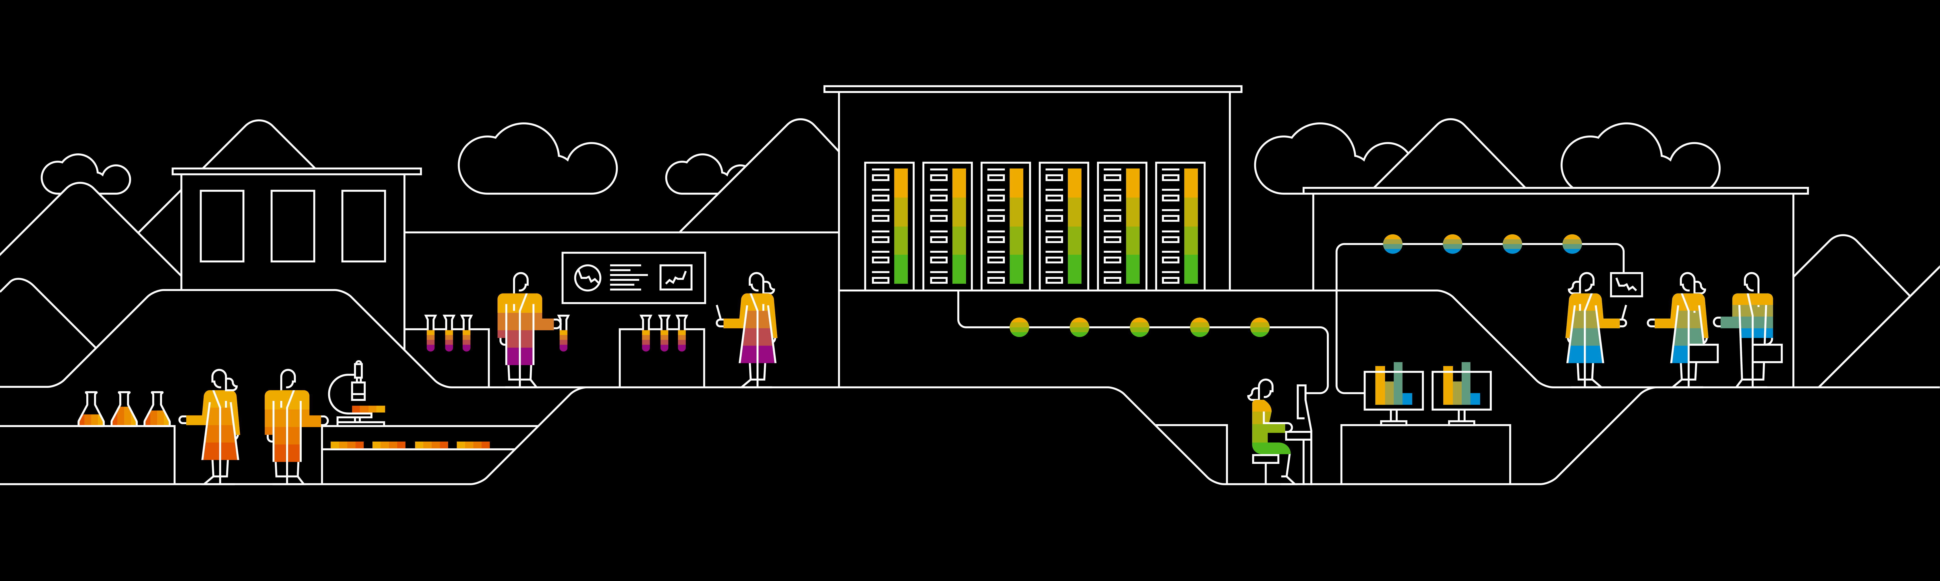
Timeline of a deployment

Slide 7
In VM world
Notes:
Build VM image with packer, create different formats for different providers, use vagrant to spin up the environment.

Slide 8
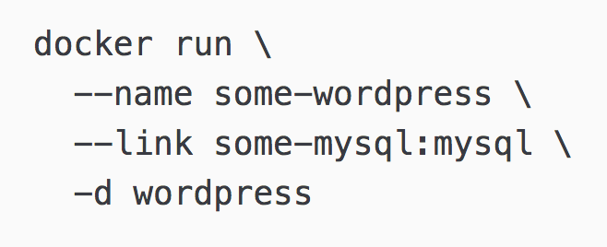
Docker
Can get a bit hard to maintain

Slide 9
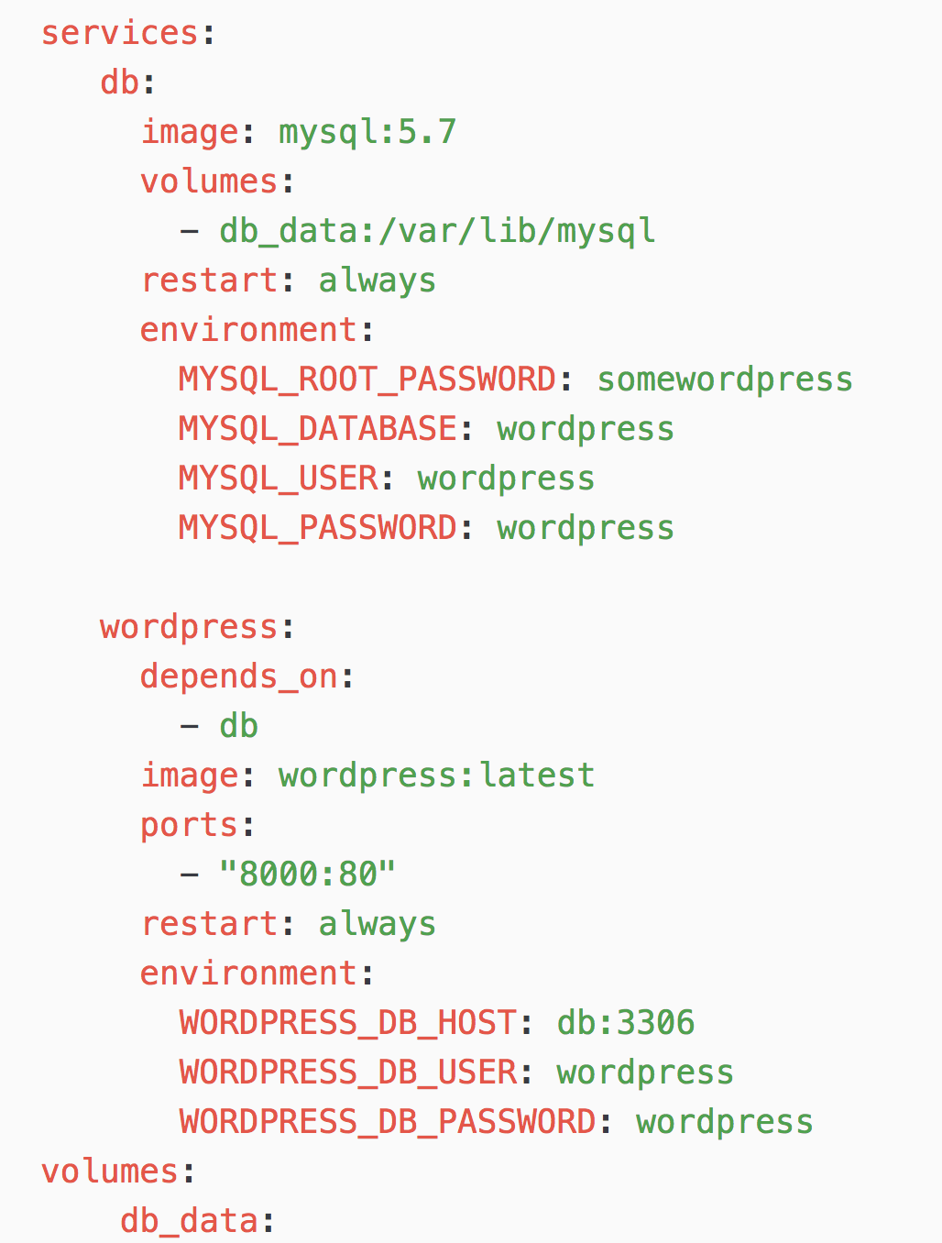
Docker Compose
When you only care about one instance* on one node then this is your solution
*of your whole application – it can include many services

Slide 10
Container orchestration
K8S
Mesos/Marathon
Docker Swarm

Slide 11
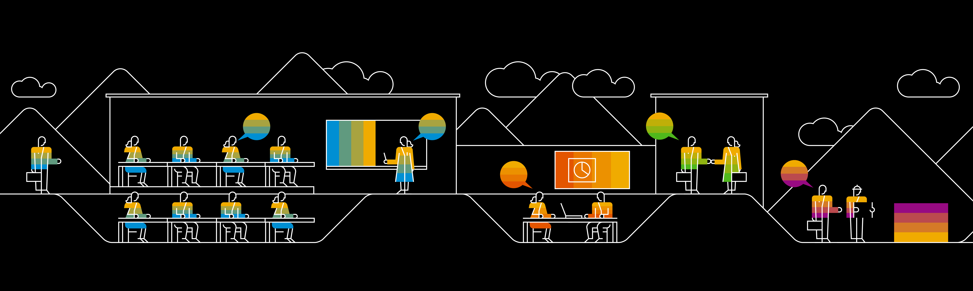
Rolling updates w Kubernetesie

Slide 12
Pod, ReplicaSet, Deployment
A Deployment controller provides declarative updates for Pods and ReplicaSets.
Notes:
Create Deployment to rollout ReplicaSet
Declare the new state of Pods
Reollback to earieler Deployment version
Scale up the Deployment to facilitate load

Slide 13
Pod, ReplicaSet, Deployment
Pod
Cont-1
Cont-2

Slide 14
Pod, ReplicaSet, Deployment
ReplicaSet
Pod
Cont-1
Cont-2

Slide 15
Pod, ReplicaSet, Deployment
Deployment
ReplicaSet
Pod
Cont-1
Cont-2

Slide 16
What Deployment actually is?

Slide 17
Deployment example + service
apiVersion: extensions/v1beta1
kind: Deployment
metadata:
name: hybris-app-deployment
spec:
replicas: 10
template:
metadata:
labels:
app: hybris
spec:
containers:
- name: hybris-app
image: heflik/hybris:v1
imagePullPolicy: Always
ports:
- containerPort: 80
apiVersion: v1
kind: Service
metadata:
name: hybris-service
labels:
run: service
spec:
type: NodePort
ports:
- port: 31000
targetPort: 80
nodePort: 32000
protocol: TCP
selector:
app: hybris
Notes:
Create Deployment to rollout ReplicaSet
Declare the new state of Pods
Reollback to earieler Deployment version
Scale up the Deployment to facilitate load

Slide 18
Deep into Deployment
Strategy.type: Recreate
Notes:
Create Deployment to rollout ReplicaSet
Declare the new state of Pods
Reollback to earieler Deployment version
Scale up the Deployment to facilitate load

Slide 19
Deep into Deployment
Strategy.type: Recreate
Pro:
Best for development
Application state entirely renewed
Cons:
Downtime of application
Notes:
Create Deployment to rollout ReplicaSet
Declare the new state of Pods
Reollback to earieler Deployment version
Scale up the Deployment to facilitate load

Slide 20
Deep into Deployment
Strategy.type: RollingUpdate
Notes:
Create Deployment to rollout ReplicaSet
Declare the new state of Pods
Reollback to earieler Deployment version
Scale up the Deployment to facilitate load

Slide 21
Deep into Deployment
Strategy.type: RollingUpdate
Pro:
Version is slowly released (declarative approach)
Zero downtime, is supporting hooks (TERM)
Cons:
Rollout / rollback can take time
No control over traffic
Notes:
Create Deployment to rollout ReplicaSet
Declare the new state of Pods
Reollback to earieler Deployment version
Scale up the Deployment to facilitate load

Slide 22
Deep into Deployment
Strategy.type: RollingUpdate
Pro:
Version is slowly released (declarative approach)
Zero downtime, is supporting hooks (TERM)
maxSurge: 2
Cons:
Rollout / rollback can take time
No control over traffic
maxUnavailable: 3
Notes:
Create Deployment to rollout ReplicaSet
Declare the new state of Pods
Reollback to earieler Deployment version
Scale up the Deployment to facilitate load

Slide 23
Deep into Deployment
Strategy.type: Blue / Green
Notes:
Create Deployment to rollout ReplicaSet
Declare the new state of Pods
Reollback to earieler Deployment version
Scale up the Deployment to facilitate load

Slide 24
Deep into Deployment
Strategy.type: Blue / Green
Pro:
Instant rollout/rollback
Change the entire app version in one go
Cons:
Requires double resources
Tests should be done before release
Handling stateful app can be hard
Notes:
Create Deployment to rollout ReplicaSet
Declare the new state of Pods
Reollback to earieler Deployment version
Scale up the Deployment to facilitate load

Slide 25
Deep into Deployment
Prod traffic
LoadBalancer
App v:1.12
Notes:
Create Deployment to rollout ReplicaSet
Declare the new state of Pods
Reollback to earieler Deployment version
Scale up the Deployment to facilitate load

Slide 26
Deep into Deployment
Prod traffic
LoadBalancer
App v:1.12
App v:1.13
Notes:
Create Deployment to rollout ReplicaSet
Declare the new state of Pods
Reollback to earieler Deployment version
Scale up the Deployment to facilitate load

Slide 27
Deep into Deployment
Prod traffic
Test traffic
LoadBalancer
App v:1.12
App v:1.13
Notes:
Create Deployment to rollout ReplicaSet
Declare the new state of Pods
Reollback to earieler Deployment version
Scale up the Deployment to facilitate load

Slide 28
Deep into Deployment
Prod traffic
LoadBalancer
App v:1.12
App v:1.13
Notes:
Create Deployment to rollout ReplicaSet
Declare the new state of Pods
Reollback to earieler Deployment version
Scale up the Deployment to facilitate load

Slide 29
Deep into Deployment
Prod traffic
LoadBalancer
App v:1.13
Notes:
Create Deployment to rollout ReplicaSet
Declare the new state of Pods
Reollback to earieler Deployment version
Scale up the Deployment to facilitate load

Slide 30
Why Canary deployment
?
Notes:
Create Deployment to rollout ReplicaSet
Declare the new state of Pods
Reollback to earieler Deployment version
Scale up the Deployment to facilitate load

Slide 31
Canary deployments
Prod traffic
LoadBalancer
App v:1.12
Notes:
Create Deployment to rollout ReplicaSet
Declare the new state of Pods
Reollback to earieler Deployment version
Scale up the Deployment to facilitate load

Slide 32
Canary deployments
Prod traffic
LoadBalancer
1-2% prod traffic
App v:1.12
App v:1.13
Notes:
Create Deployment to rollout ReplicaSet
Declare the new state of Pods
Reollback to earieler Deployment version
Scale up the Deployment to facilitate load

Slide 33
Canary deployments in Kubernetes
?
Notes:
Create Deployment to rollout ReplicaSet
Declare the new state of Pods
Reollback to earieler Deployment version
Scale up the Deployment to facilitate load

Slide 34
Rolling updates w Kubernetesie
DEMO

Slide 35
Demo agenda
Sample deployments and service
Rolling update
Rollout app v:1
Update to app v:2
Update to app v:3 (doesn’t exist)
Rollback to app v:2
Canary in K8s
Notes:
Create Deployment to rollout ReplicaSet
Declare the new state of Pods
Reollback to earieler Deployment version
Scale up the Deployment to facilitate load

Slide 36
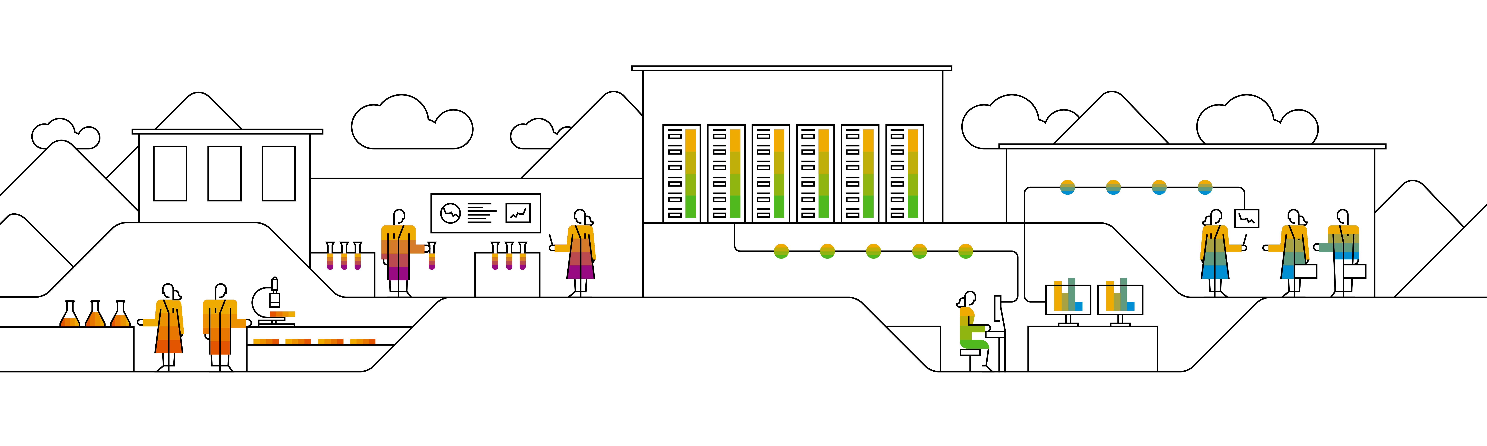
HorizontalPodScaling w Kubernetesie

Slide 37
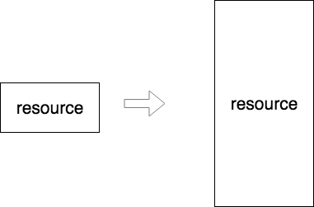
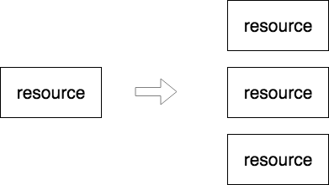
Horizontal vs vertical scaling
Vertical scaling
Horizontal scaling

Slide 38
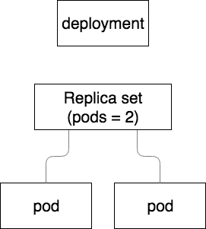
Horizontal pod scaling in Kubernetes
Deployment without hpa

Slide 39
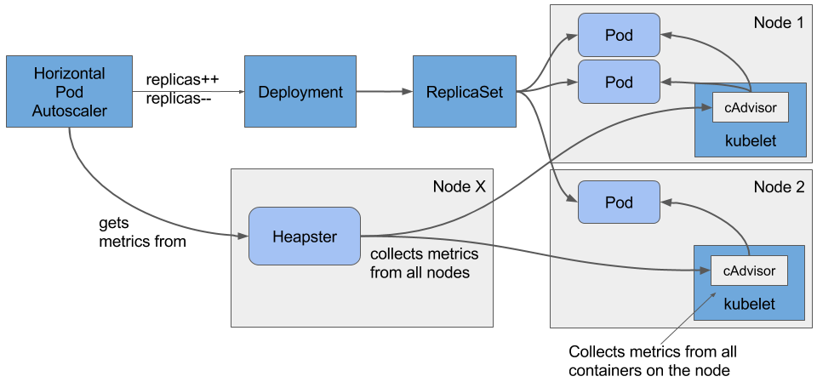
Horizontal pod scaling in Kubernetes
Deployment with hpa

Slide 40
HorizontalPodScaling DEMO

Slide 41
Smarter deployments in Kubernetes

Slide 42
Helm – The package manager for Kubernetes

Slide 43

What is Helm?
„ Helm is a tool that streamlines installing and managing Kubernetes applications. Think of it like apt/yum/homebrew for Kubernetes.”
Helm has two parts: a client (helm) and a server (tiller)
Tiller runs inside of your Kubernetes cluster, and manages releases (installations) of your charts.
Helm runs on your laptop, CI/CD, or wherever you want it to run.
Charts are Helm packages that contain at least two things:
A description of the package (Chart.yaml)
One or more templates, which contain Kubernetes manifest files

Slide 44
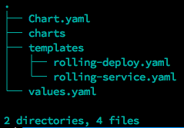
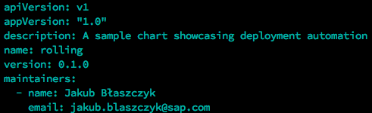
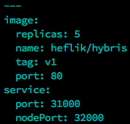
Example Chart structure
Chart.yaml – Metadata of the chart (name, version, maintainers)
Charts directory – Your local dependencies
Templates directory – Your code: kubernetes manifests + go based templates
Values.yaml – Your default values.

Slide 45
The helm repo
Official helm repository: https://github.com/kubernetes/charts
Github based repositories:
https://github.com/kubernetes-helm/monocular/tree/master/deployment/monocular
https://raw.githubusercontent.com/SAPHybrisGliwice/devops-community_chapter2/master/JB-helm
Support for private repositories: http://helm-repository.yrd.rot.hybris.com/

Slide 46
Lets improve the previous deployments

Slide 47
Some more advanced examples

Slide 48
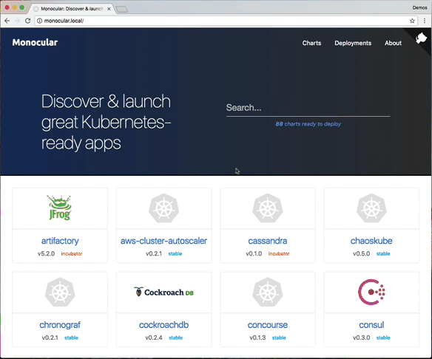
Monocular – The helm WebUI
View avaliable charts (official and private repos)
View running deployments
Install & delete deployments

Slide 49
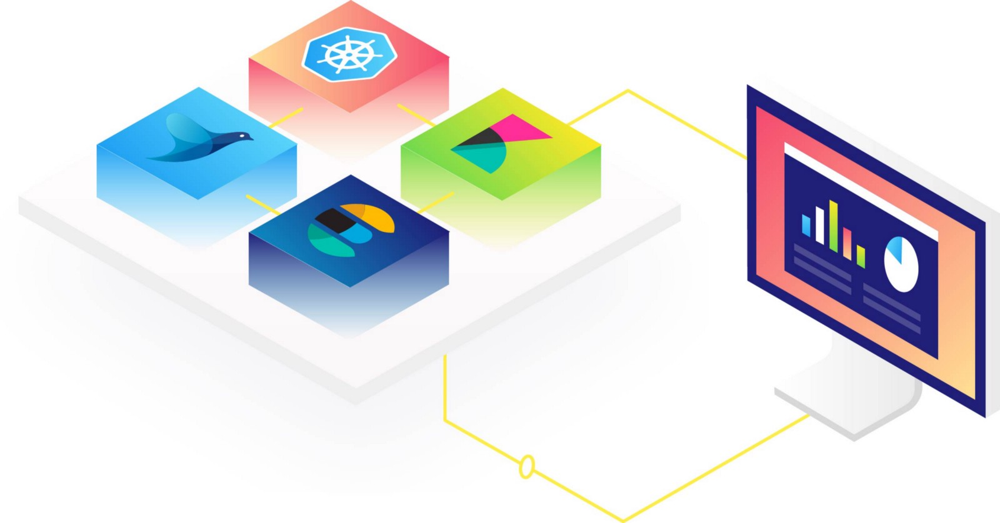
EFK – Complete logging solution
Our custom build solution
Enables log aggregation and analytics for cluster
Access to kubernetes metadata (manifest labels, node labels, docker info)

Slide 50
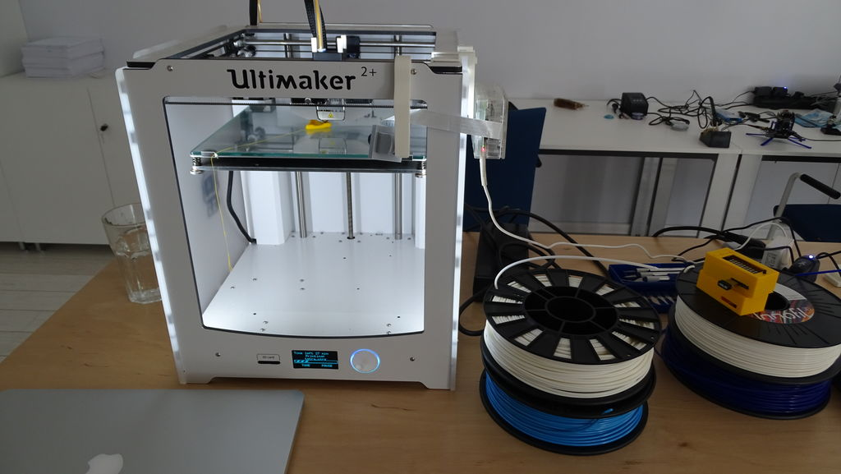
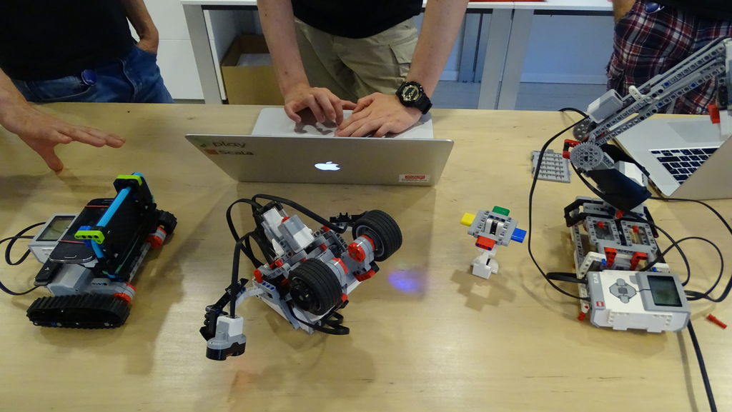
Kogo szukamy?
Profesjonalistów
Cloud Software Engineer
(Cloud Native Solutions, Go, NodeJS)
Senior Software Developer (Cloud)
(Java, DevOps tools, Ruby, Go)
Java Engineer and Developer
(Java, Spring Core, Boot and Cloud, Web Services)
Studentów
Cloud Software Engineer - intern
(Cloud Native Solutions, Go, NodeJS)
IT System Administrator - intern
(Support, monitor hardware and software on Linux)
QA Analyst - intern
(Automated, Exploratory tests)
DevOps Engineer
(Bash, Groovy, Python, Ruby, Go)
Aplikuj tutaj
https://goo.gl/sN3Jyf
Notes:
Płatny Staż – lipiec - wrzesień:
D-shop
RaspberryPi
Arduino
Espruino
Drukarka 3D
Platformy jezdne do RaspberryPI
Sprzęt: lutownica, oscyloskop

Slide 51


Networking session ☺
Opcja 1
Zapraszamy na zwiedzanie biura
Opcja 2
Q&A z naszymi prowadzącymi
Opcja 3
Speed Interviews
Notes:
Grupa 1 – Zwiedzanie biura
Grupa 2 – Q&A - Edyta, Ivijan, Dare
Karolina, Paweł – speed interviews

Slide 52

Thank you.
Github:

